Slide 1
eBook: Mas que un Libro
“Las bibliotecas intentan afrontar un futuro en el que han desaparecido prácticamente todos los puntos de referencia. Los usuarios están cambiando, al igual que el contenido.
La investigación está tomando nuevas formas”.
Derek Law, centro de investigación de bibliotecas digitales
Alvaro Ybarra Muguruza

Slide 2
Agenda
1.El valor de los libros en el proceso de la investigación.
Beneficios para bibliotecarios e investigadores
2. La utilización de Ebooks: tendencias y casos específicos.
3.El valor de las editoriales: las plataformas y el contenido.
4.Movimiento Digital, Movimiento Portátil.
5.Contenido Elsevier.

Slide 3
El valor de los libros en el proceso de la investigación

Slide 4
1.1 El valor del contenido de los libros en el proceso de la investigación
Conceptos básicos
Profundización y aplicación de metodologías
Adición de información actualizada del campo
Ampliación de la perspectiva
Libros: 72%
Libros : 58%
Libros : 32%
Libros: 55%
Publicaciones periódicas
Enciclopedias
Manuales
Títulos de primera línea
Fondo editorial
Según una encuesta reciente, el 92% de los investigadores realiza periódicamente tareas de investigación interdisciplinar.
El acceso a los conceptos básicos [LIBROS] de cada disciplina es CRUCIAL.
Source: global survey responses from 500 researchers & librarians, Elsevier & S.M.S. Research, 2009
Notes:
Who needs book content? What is the value of books to the research workflow? This chart shows researchers’ choice of content as they progress through the stages. Notable findings:
In the fundamental knowledge stage: Researchers prefer books 72% over journals, as books are a solid source of proven information
As researchers deepen and apply methodologies, they turn to books more than half of the time, and rely on newer findings from a reliable source
Once they understand and explore the core topics under study, adding currency from the field helps them challenge accepted views, and at this stage, journals are most valuable
With a strong foundation, deeper insight, and currency from the field in their own area, researchers want and need books to help broaden their perspective—throughout the research workflow as they continue to explore related areas of research.
What this shows is that resarchers want, need—and truly value a mix of books and journals, and in most stages of their workflow, books are an extremely valuable source for finding the information they need—fast.
Further, 92% of researchers surveyed told us that increasingly they are performing cross-disciplinary research and their need for foundation content in NEW areas is essential as they research across areas of expertise to build foundation knowledge and comparative perspective in new or related fields.

Slide 5
No es ninguna sorpresa que el elemento más citado en Scopus sea un libro.
24%
Most cited item in Scopus is a book
Notes:
If we take quantifiable metrics like citations…
very little exists for online books: Books are not systematically indexed for citations like journals
Yet if we look at Scopus data, we see that the most cited item in SCOPUS is a book…

Slide 6
1.2 El valor de los libros en formato electrónico respecto al formato impreso: ventajas para los investigadores
El valor de los libros en formato electrónico para la productividad del flujo de trabajo
de la investigación:
Accesibilidad
Flexibilidad
Capacidad de búsqueda
Comodidad
Fiabilidad
Notes:
We asked researchers what content is most valuable to their research workflow productivity, and they said that they want—and need:
Accessibility
Flexibility
Searchability
Convenience
Let’s take a closer look…
Source: SMS Research, responses from researchers worldwide (50)

Slide 7
Accesibilidad..
A cualquier hora… En cualquier lugar...
Fuera del campus
Otros (in situ)
Bibliotecas
En casa
Conexión inalámbrica
Fuente: Estudio sobre libros en formato electrónico de la Universidad de Tennessee, noviembre de 2007
Notes:
Accessibility anytime, anywhere allows researchers to work whenever—and wherever they want or need to:
Notice that a significant amount of research is done between the hours of 12:00 a.m. and 8:00 a.m.—after the library closes; and less than half of research is actually done in the library
With today’s researchers multi-tasking lifestyle, accessibility is by far the most desirable benefit of using eBooks versus using print books that not as readily available or as accessible.

Slide 8
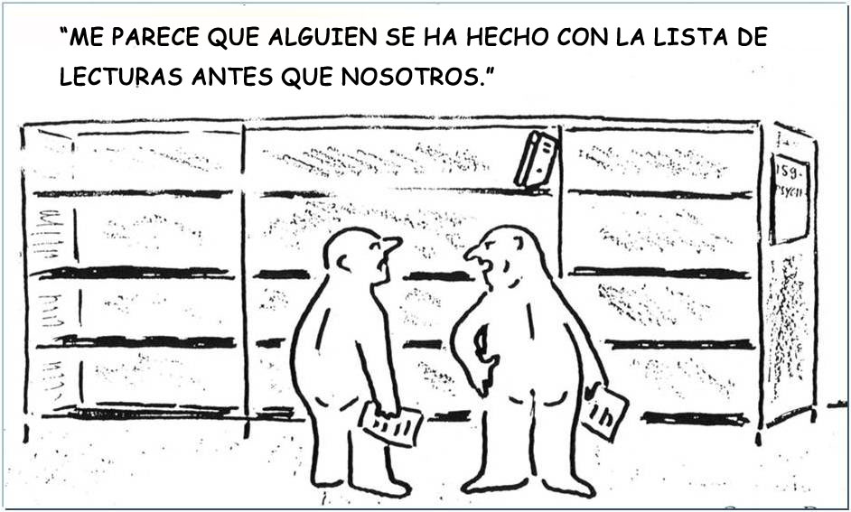
Flexibilidad..
Enlaces directos al texto completo de documentos en formato .pdf o HTML.
Varios usuarios simultáneos.
Descarga e impresión.
Sin restricciones de administración de derechos digitales (DRM)
Notes:
Imagine—
Before online books, researchers relied upon finding the material they needed on the shelf—but today’s technology enables the flexibility to find the content they need—when they need it.
With eBooks, flexibility features can include these:
Direct links to full text .pdf or full text HTML content
Multiple simultaneous users can access the same book at the same time—
Easy download and print
No DRM Restrictions

Slide 9
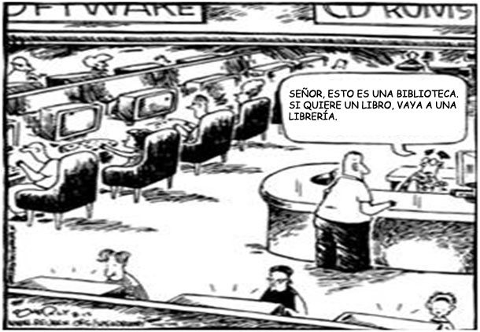
Capacidad de búsqueda..
Los investigadores encuentran y eligen más información de la que necesitan, con mayor rapidez que si buscasen en los estantes de una biblioteca.
Notes:
Powerful search functionality associated with online books is another benefit that researchers cannot get from using printed works alone. The ability to perform a search for relevant content across books and journals gives researchers reliable choices for using reliable content throughout the research process—much more quickly and accurately than they could do by searching the shelves in a reference library restricted to print.

Slide 10
Comodidad
Contenido integrado de libros y publicaciones periódicas, y herramientas de citas sobre una gran variedad de temas
Recuento de citas de Advances in Cancer Research
Cognition
Encyclopedia of Neuroscience
Libros
Publicaciones periódicas
Índice h de Gerry T.M. Altmann
Cancer Cell
Base de datos de citas
Current Biology
Neuron
Learning & Memory
Advances in Cancer Research
Índice h de Paul W. Glimcher
Molecular & Cellular Neuroscience
Signal Processing for Neuroscientists
Notes:
Integration of book and journal content—and citation tools across a diverse range of subjects offer researchers the most convenient solution for accessing the content they need—when they need it.
Researchers also value finding relevant information that they were NOT searching for when it’s presented contextually—and with brief abstracts or previews to empower them to choose additional, relevant content—or not.
Today’s picture of researchers: They go online and they are used to having hyperlinked content, from citation to citation, where books refer to journals and vice versa—and restricting their use to one or the other, they lose a valuable piece of the research process.

Slide 11
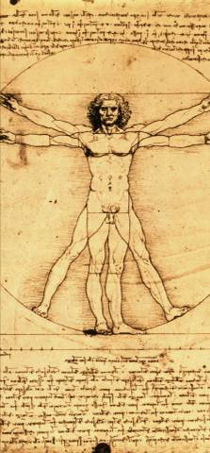
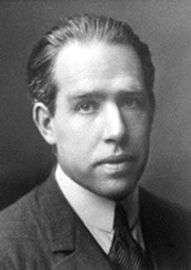
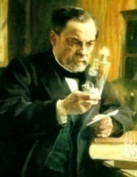
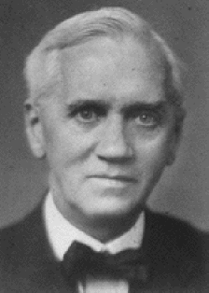
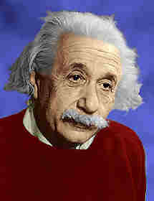
Fiabilidad..
Elsevier: una larga tradición en la publicación de obras capitales
La editorial Elzevir se fundó en 1580 de la mano de Lowys Elzevir. Jacobus George Robbers creó la moderna empresa Elsevier en 1880.
Galileo publicó “Discurso y demostraciones matemáticas en torno a dos nuevas ciencias”, su última obra con Elzevir, a pesar de ser condenado por la Inquisición. Se ha considerado la primera obra importante de la física moderna.
Sir Alexander Fleming editó un libro sobre un nuevo antibiótico revolucionario:
“Penicilina. Su aplicación práctica” en 1946.
de Gray” en 1858 supuso un punto de referencia para el estudio de la anatomía humana y, en muchos aspectos,
La publicación de “Anatomía de Gray” en 1858 supuso un punto de referencia para el estudio de la anatomía humana y, en muchos aspectos, para la medicina en general.
Premios Nobel publicados en Elsevier
Niels Bohr Física
Louis Pasteur Química
Alexander Fleming
Medicina
Albert Einstein Física
George F. Smoot Física
John C. Mather Física
Roger D. Kornberg Química
Craig C Mello Medicina
Notes:
Elsevier’s long heritage of publishing leading eBooks started in 1580 at the House of Elzevier—and later in 1880 became Elsevier. From Gallileo to Sir Alexander Fleming, Einstein, and a long line of Nobel prize winners—Elsevier has always been associated with the most renowned authors—and the most rigorous process for producing and distributing high quality content. That matters to all users, in any format, and that will not change regardless of delivery.

Slide 12
1.3 El valor de los libros en formato electrónico respecto al formato impreso: ventajas para las bibliotecas
Criterios de conversión
Uso
Coste
Notes:
In today’s uncertain economic times, it’s clear that the libraries decisions based largely on budget and other measurable criteria that they say can validate their choice in content and delivery/format in the process of collection and acquisition.

Slide 13
¿ ¿ Qué factores decisivos impulsan a los bibliotecarios a considerar los libros en formato electrónico ANTES de adquirirlos?
Fuente: 2009 SMS Research/Respuestas de 450 bibliotecarios de todo el mundo a la encuesta de Elsevier
Notes:
According to over 450 responses to a recent, global survey of librarians, these are the impact factors that are considered most when choosing online books over print for the first time.

Slide 14
¿Cuáles son las principales ventajas que destacan los bibliotecarios DESPUÉS de adquirir libros en formato electrónico?
Ventajas/factor decisivo para incrementar el contenido en formato electrónico | Porcentaje
Accesibilidad 24 x 7 | 69%
Varios usuarios simultáneos | 26%
Rapidez de consulta y búsqueda | 20%
Coste | 19%
Preferencia de los usuarios por el contenido en línea | 13%
Mayor facilidad de localización de información y uso | 13%
Facilidad de uso | 11%
Fuente: 2009 SMS Research/Respuestas de 450 bibliotecarios de todo el mundo a la encuesta de Elsevier
Notes:
Note the change in perception that occurs after librarians do acquire online books instead of print—and are considering expansion of their online content (over print):
Cost moves from the first to fourth factor, as librarians and researchers see the value of 24/7 accessibility, multiple simultaneous user access, and powerful search and browse.
The result is that books are more discoverable, and in turn usage increases and libraries can experience a significantly lower cost per chapter. When that happens, it becomes possible for librarians to provide more content for more patrons—with less shelf space required AND with a lower cost per chapter for their online holdings versus print.

Slide 15
¿Qué prefieren utilizar los investigadores: contenido impreso, electrónico o ambos? Los bibliotecarios encuestados afirmaron…
“Por tema, los usuarios prefieren:” | Libros en formato electrónico | Libros impresos | Ambos
Ciencias agrícolas y biológicas | 23% | 20% | 58%
Bioquímica, genética y biología molecular | 35% | 14% | 51%
Ingeniería química | 40% | 14% | 46%
Química | 35% | 15% | 49%
Informática | 65% | 7% | 28%
Ciencias planetarias y de la tierra | 24% | 21% | 55%
Energía | 33% | 13% | 54%
Ingeniería | 43% | 9% | 48%
Ciencias ambientales | 23% | 18% | 59%
Inmunología y microbiología | 29% | 17% | 54%
Ciencia de los materiales | 39% | 13% | 49%
Matemáticas | 21% | 36% | 43%
Medicina y odontología | 26% | 13% | 62%
Neurociencia | 34% | 18% | 48%
Farmacología, toxicología y ciencias farmacéuticas | 31% | 16% | 53%
Física y astronomía | 31% | 18% | 50%
Psicología | 15% | 28% | 57%
Ciencias veterinarias y medicina veterinaria | 26% | 20% | 54%
Todos los temas:
Libros en formato electrónico: 32%
Todos los temas:
Ambos: 51%
10.600 libros en línea y
artículos integrados sobre una gran variedad de temas
10.600 libros en línea y
artículos integrados sobre una gran variedad de temas
Todos los temas:
Impreso: 17%
Fuente: 2009 SMS Research/Respuestas de 450 bibliotecarios de todo el mundo a la encuesta de Elsevier
Notes:
When it comes to deciding to acquire print books, e books, or both—most librarians say their budget will not allow “both”; however they do report that they “THINK” their patrons’ choices would vary but subject area.
Note the overall outcome is that librarians’ perception, overall, is that their patrons would prefer both, with significantly more who say their patrons, if given a choice, would choose e over print.
What do you think your patrons would say?....

Slide 16
¿Qué prefieren utilizar los investigadores:
contenido impreso, electrónico o ambos?
Los investigadores dicen…
Los bibliotecarios dicen…
“Tanto el personal docente como los estudiantes prefieren el contenido en línea, por lo que estoy convirtiendo la mayoría de los libros de referencia de la biblioteca al formato electrónico.
El material impreso no se utiliza; se queda en los estantes.”
Impreso
Ninguna preferencia
En línea
N.º de investigadores
Fuentes: Global Faculty eBook Survey 2007 (E-brary); encuesta a usuarios de
Global ScienceDirect, S.M.S. Research 2009, respuestas de 450 bibliotecarios
Notes:
When asked what they prefer, most researchers said they prefer online only, with some saying they had no preference, and very few saying they still want print.
In recent conversations with librarians who made the switch to online books and anticipated complaints from their users, many have said that in actuality, they had ZERO complaints from end users they thought would ask for the print versions. Increasingly, it seems that when online books are in the library, they are used and preferred by patrons.

Slide 17
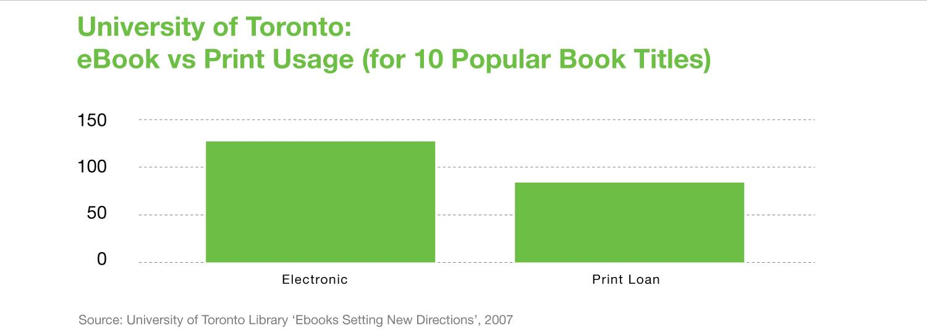
Mayor uso de los libros en formato electrónico
Notes:
The University of Toronto conducted a usage study in their library to compare the usage of 10 books they had available in their library in BOTH print and e format.
As you can see here, for the full year 2007, these top ten eBook titles were used significantly more than their print counterparts. The University of Toronto attributed this to increased discoverability of the eBooks, which were far more available—to all students at all times, in the library and remotely.
In this case, and in many cases like this—electronic usage was higher than printed copies—despite the fact that the University of Toronto had multiple copies of the printed version.

Slide 18
Mayor uso de los libros en formato electrónico: Préstamos.
Promedio de préstamos de libros impresos en 120 bibliotecas: 1,3 por título al año.
Fuente: SCONUL
Promedio de préstamos de libros impresos en 130 bibliotecas: 0,18 por título
al año.
Fuente: ARL
Promedio de descargas de libros en línea: *25 por título
al año.
*
*Fuente: Datos de uso de ScienceDirect durante el primer año de adquisición
Notes:
A closer look at expected usage of print (as quantified by SCONUL and ARL) show a significantly lower usage rate, by title during the first year of acquisition for the average printed book VERSUS the same criteria for online books.
NOTE TO ELSEVIER PRESENTER: online books criteria based on SD usage for full year 2008—do not mention unless asked, as we are not yet “selling” ScienceDirect.

Slide 19
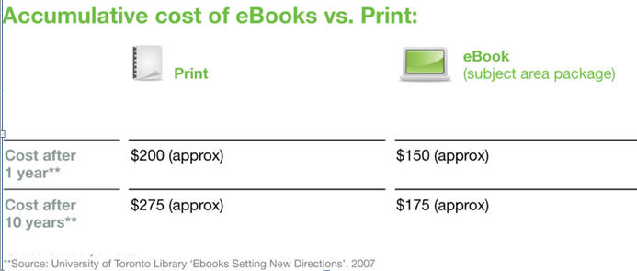
Coste acumulativo: libros en formato electrónico y libros impresos Universidad de Toronto
Notes:
The University of Texas looked at the accumulative cost of eBooks versus print books based on actual costs for the first year of acquisition—and predicted accumulative cost at year ten.
Accumulative costs factored in higher ongoing cost for printed books…

Slide 20
Libros impresos: la ecuación de costes
Acquisition
$48
(one time)
Book Handling
$5
(recurring)
Operational
$3
(recurring)
56 USD
Con los libros en formato electrónico estos costes son mínimos.
Adquisición
48 USD
(una sola vez)
Manipulación de los libros
5 USD
(recurrente)
Coste operacional
3 USD
(recurrente)
Coste operacional
(anual)
Edificio, personal, consumo energético y gastos generales.
Manipulación de los libros
(anual)
Encuadernación y conservación,
transacciones, catalogación, archivo y sustitución.
Fuente: Estadísticas de SCONUL (GB) y ARL (EE. UU.)
20
Notes:
Let’s take a closer look at the cost equation as averaged by SCONUL in the UK and ARL in the US.
Take a print book that starts at $48 for acquisition, but “really” has a price tag of $56. year over year.
Additional costs that are likely to occur every year at full rate for printed books: Recurring book handling, from binding and preservation to interlibrary loans, cataloguing, archiving, and replacement if lost or stolen. These costs are marginal with eBooks since they do not require maintenance and can’t be lost or stolen.

Slide 21
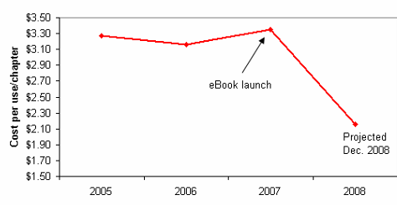
Conclusión:
el coste por uso global disminuye a medida que se incrementa el uso.
A medida que aumenta el uso de los libros en formato electrónico en ScienceDirect…
Número de capítulos
descargados (en millones)
el coste por capítulo disminuye…
PPV de ScienceDirect: 30 USD por artículo
Aparición de los libros en formato electrónico
Coste por uso/capítulo
Entrega de documentos de British Library: 30 USD por artículo
Aprox. 2 USD por capítulo
Fuente: Datos de uso de ScienceDirect 2005-2008
Notes:
Note:
-Document delivery of book chapter via the British Library: $30
Paper View on ScienceDirect: $30
But when compared with total cost per usage data gathered for books on ScienceDirect over the past 3 years, the average cost per use is ONLY TWO DOLLARS.
This cost analysis shows almost incredible value for library acquisition of online books that, if purchased one chapter at a time by one user at a time would cost exponentially more.

Slide 22
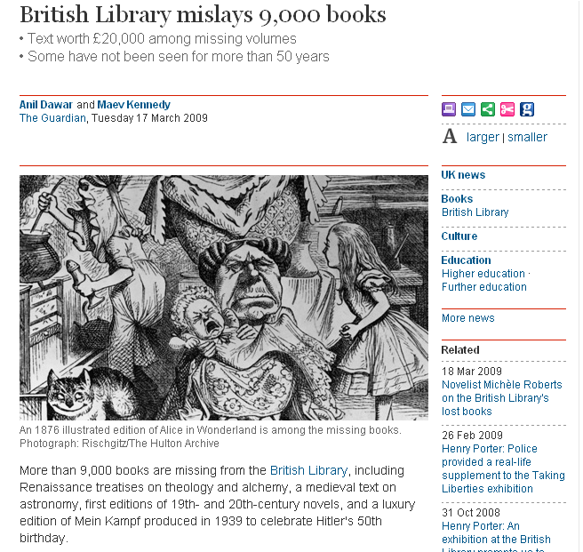
¿Ha perdido alguna vez un libro impreso de la biblioteca?
Notes:
And imagine the cost-savings for the British Library alone, who could justify replacing 9000 print books that they acquired and are no longer available to their users because they have been lost. That is never an issue with online books because they are accessible and available at all times, to all users.
At the rate of $56 per book (or at any rate), replacing 9000 books would cost $504,000 based on average print book cost—and since the British Library is unlikely to have that kind of budget to rebuy all of those books, they and their users are at an unrecoverable loss.
This is an extreme example but one that is worth mentioning, as many librarians have stated the same concerns and situations in smaller doses—with books being lost and stolen.

Slide 23
2. La utilización de Ebooks: tendencias y casos específicos.

Slide 24
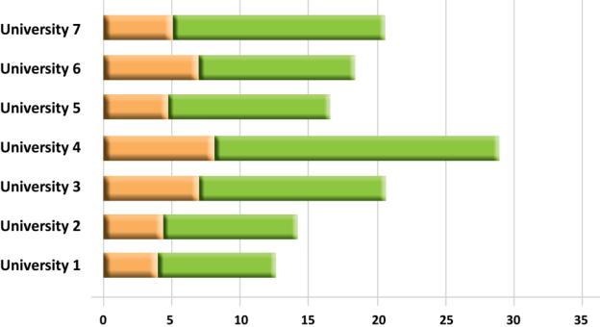
El acceso al contenido electrónico ahorra al investigador una media de 2-4 horas.
Menor tiempo de búsqueda de información equivale a mayor tiempo de procesamiento para la innovación.
Búsqueda & Acesso a
Revistas y Libros
Lectura de libros &
artículos
Horas a la semana
Conclusiones
Encuestados informan que utilizan al menos 3.5 horas a la semana buscando y accediendo artículos y por lo menos 9.8 horas leyéndelos.
Source: University Investment in the Library, Phase II: An International Study of the Library’s Value to the Grants Process, 2010, Elsevier and 8 academic partners
Notes:
. Access to electronic content saves approximately 2-4 hours per use, per occasion
Less time searching equals more time innovating to accelerate science

Slide 25
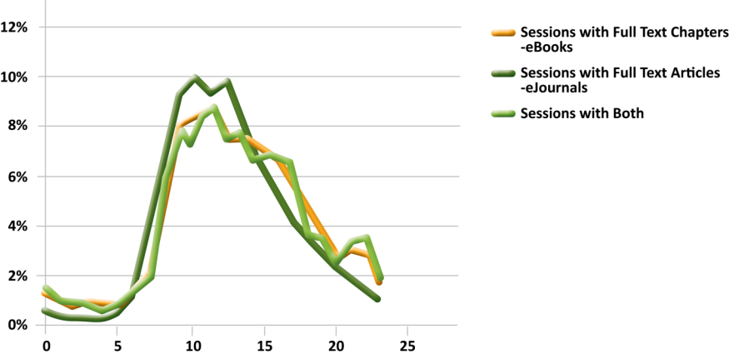
Uso Diario Medio: Uso 24 horas (Usuarios de ScienceDirect)
Ebooks & las revistas online son usados casi siempre con la misma frecuencia, presentando el mismo valor de contenido integrado, siendo de descubrimiento y disponibles.
Source: ScienceDirect usage data 2010: All users, all eBook (Monographs)
Notes:
A look at usage of ScienceDirect over a 24-hour period for all academic customers in Europe, the Middle East and Africa shows that a considerable portion of full-text eBook and eJournal article downloads occur outside a library’s opening hours. This points to one of the main benefits of online books as recognized by researchers: They are always available and many users can access them concurrently with integrated journal content also available to subscribed users on ScienceDirect.

Slide 26
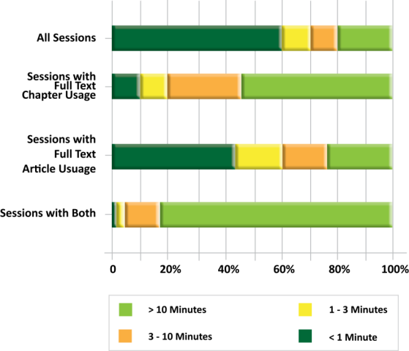
Uso de Texto Completo: Capítulos de eBook & Artículos de Revistas
Sesiones con Ebooks duran mas que con las Revistas Online
La tarea de encontrar los artículos mas pertinentes de tema nuevo solían requerir toda una tarde. El mismo trabajo se puede conseguir ahora en 15-30 minutos
Source: ScienceDirect usage data 2010
Notes:
Sessions with Ebook usage generally longer than sessions with E-journal usage
Sessions where full-text from Online Books on ScienceDirect was accessed and downloaded lasted considerably longer than sessions involving full-text journal articles. More than half the sessions with full-text book chapter usage lasted longer than 10 minutes; 10% lasted less than one minute. By comparison, 45% of sessions where full-text journal articles were accessed lasted less than one minute while only 25% lasted longer than 10 minutes.
The increased length of book sessions is likely due to the different discovery and assessment patterns shown by researchers when looking at online books. First they want to ascertain the relevance of a particular book for their research and then, once they decide it is relevant, they choose which chapters to download. In some cases they will download the entire book even if they only plan to read one or two chapters.

Slide 27
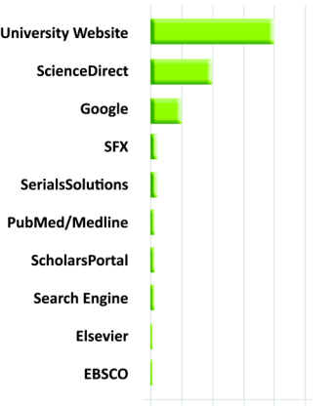
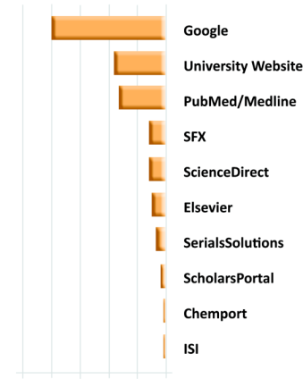
El Camino más habitual hacia Ebooks & Revistas Online
(Top 10) Navigating to eBooks
(Top 10) Navigating to eJournals
El Punto de Entrada ?
Para Ebooks es la Página Web de la Universidad
Para Revistas es GOOGLE
Source: ScienceDirect usage data 2010
Notes:
Based on the log file analysis portion of this study, usage behaviour amongst ScienceDirect’s global customer base suggests that Online Books on ScienceDirect are accessed primarily via library websites, followed by the ScienceDirect search & discovery platform itself, and Google.7 This is in contrast to journals which are most often accessed via Google first and then the library website or Medline/Pubmed.

Slide 28
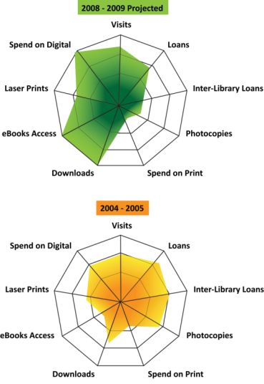
Abrazar Ebooks significa abrazar el cambio..
University of Cardiff, UK
Estos diagramas demuestran el cambio de la provisión de servicios físicos en la Biblioteca de Cardiff hacia mayor uso de contenido digital.
El numero de usuarios se mantienen en un numero muy alto
Source: University of Cardiff Annual Repot 2010
Notes:
As you’ll see as we move on, embracing the eBook to accelerate science means embracing CHANGE.
Data like this points to the changing role of the library in the midst of migration from print to online delivery, and the fact that students still rely on the library and it’s information services. In fact, many customers who are going digital tell us that even though there is less physical space in the library, they are reaching more patrons with more content by going digital, so in turn they are becoming a more centralized part of the university’s mission.

Slide 29
“Los libros en formato electrónico y los registros de catálogo asociados generados electrónicamente facilitan y agilizan al personal la adquisición, la promoción y el “préstamo” de libros. Además, su coste por uso es inferior al de los libros impresos. Permiten reducir tanto el espacio que se precisa para albergar la colección de obras como la necesidad de manipulación física, lo que genera un recurso de información “más ecológico”. El ahorro de costes, espacio y tiempo puede invertirse en otras prioridades, como convertir la biblioteca en un lugar más acogedor e incrementar su importancia en el campus. Los recursos obtenidos de la migración de la colección de libros impresos al formato electrónico se utilizaron para contribuir a desarrollar e implementar un plan que atrajese a un mayor número de personas a la biblioteca. El resultado es que las visitas se han incrementado de forma significativa. El hecho de disponer de más espacio se ha traducido en la creación de más zonas de estudio en grupo. Por otro lado, se ha implantado una normativa más tolerante respecto al ruido y el consumo de comida y bebidas, y se ha instalado acceso inalámbrico a Internet.”
Robert Thomas, director de biblioteca
Hargrave-Andrew Library, Monash University Australia
Notes:
To summarize, digital libraries such as this case of Monash University are seeing a return on investment that’s both financial and personally beneficial. All of these benefits are associated with a case study we conducted at Monash, but we are hearing from many customers:
It’s easier for staff to find and lend books
The cost per chapter for eBooks is lower than print
The library reduces the need for physical handling, e.g. recurring fees that are more apparent with print books
Cost, space, and time savings can be redirected to other priorities
Door counts increase significantly, e.g. more users are coming to the library
More floor space translates into benefits for today’s library users, e.g. more group study areas

Slide 30
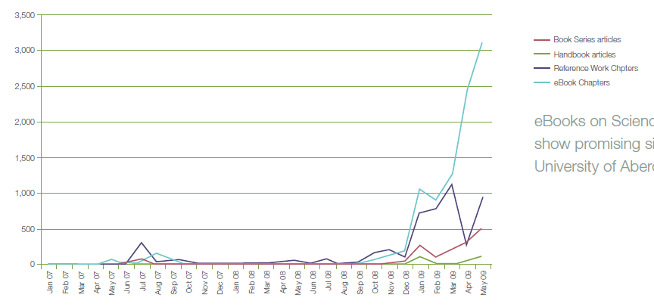
Caso Práctico:
6 Meses después de Compra
Los informes indican y sugieren que nuestra colección de Ebooks se ha integrado con éxito, solo 6 meses después de la compra. Seguiremos buscando nuevas evidencias para contabilizar y justificar los resultados
Chris Banks, Bibliotecaria de la Universidad de Aberdeen
Casi el doble de uso en el segundo año | % de la coleccion
Número de títulos utilizados 2009 | 28.50%
Número de títulos utilizados (2009,2010) | 50.81%
% 2009 títulos re-utilizados en 2010 | 51.58%
Notes:
40% of print books are unused 6 years after purchase!
Source: Kent, A et al, Use of Library Materials:
The University of Pittsburgh Study).

Slide 31
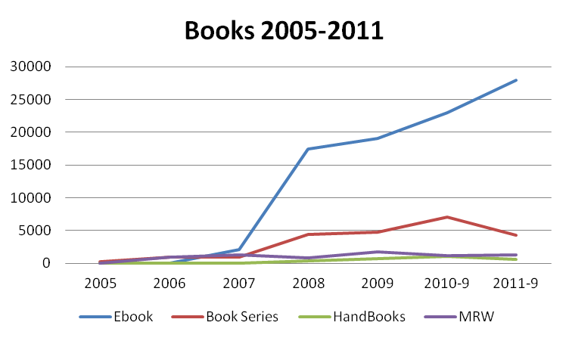
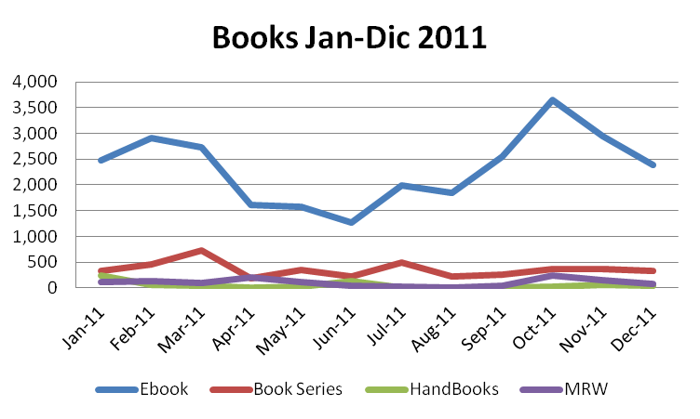

Slide 32
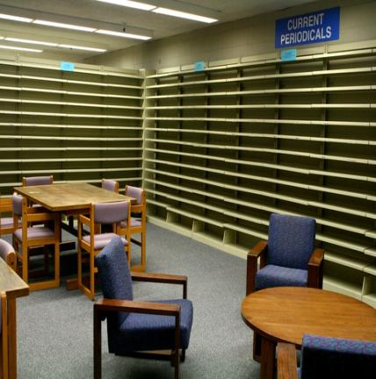
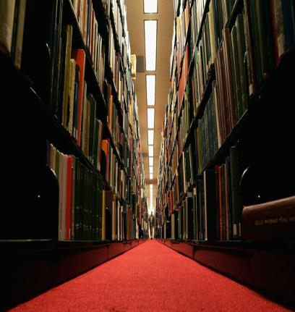
Baldas de la Biblioteca de Ingeniería de Stanford : Casi Vacías!
In 2010, la Biblioteca de Ingeniería de Stanford vaciaron el 85% de sus baldas por Ebooks
Casi todas las publicaciones periódicas son online
Desde los últimos 5 años, casi todas las revistas de ingeniería se han convertido en versión On-line, convirtiendo sus versiones en papel obsoletas-Los libros no lo están haciendo mucho mejor!!
Helen Josephine, Biblioteca de Ingeniería de Stanford
La gran mayor parte de los libros en papel, no han salido de sus baldas en años!!
Michael Keller, Director de la Biblioteca de Stanford

Slide 33
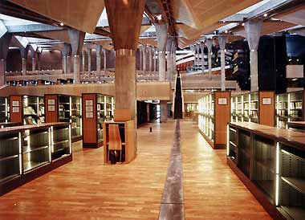
Bibliotecas Nacionales:
Empujando la migración del papel al digital
Bibliothèque National de France
Biblioteca Nacional de Corea
626 ordenadores, 380,000 libros digitalizados, 116 million de elemento de contenido digital.
Bibliotheca Alexandrina
Notes:
After seven years of preparation, the Digital Library opens at the National Library of Korea in Seocho. Keyword searches on its Web site enable users to access 116 million source materials located in libraries both in Korea and overseas.
626 computers are available
And other national libraries such as the University of Illinois and Stanford are also actively migrating and seeing that while the shelves are gone, the library is being used more.

Slide 34
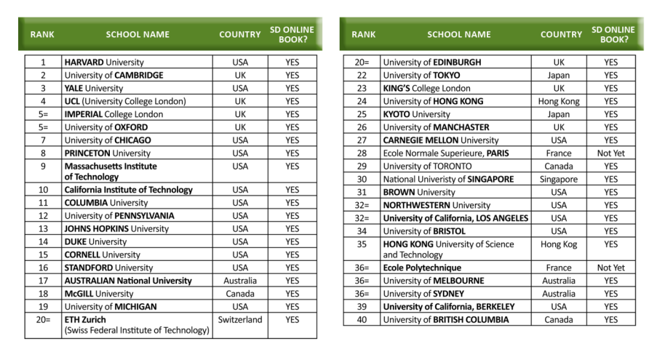
Las 40 Grandes Universidades
Source: The QS World University Rankings ‘09
34
Notes:
This explosion of eBooks is happening globally. Is your country on the list? Why or Why not?
Source: ScienceDirect usage data, 2007-2008

Slide 35
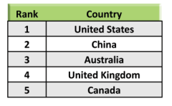
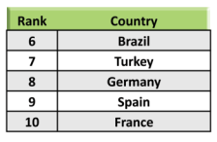
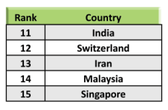
Una Visión Global de la Migración
Source: ScienceDirect online book usage Data
Notes:
Where in the World are ScienceDirect eBooks users? Here’s a view from our SD usage data showing the top 15 countries who are going digital with eBooks on ScienceDirect. And Libraries and patrons around the world are seeing the benefits.

Slide 36
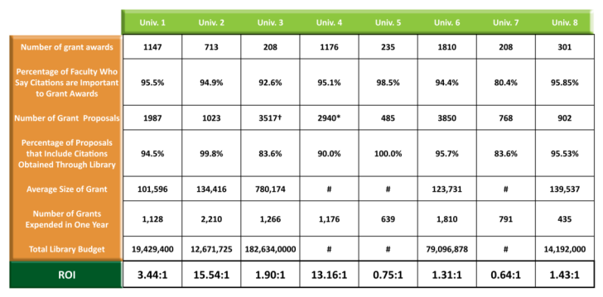
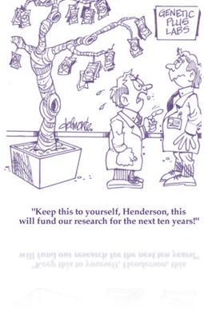
Las Bibliotecas Digitales de hoy en día, añaden valor hacia sus instituciones
Conclusiones
Por cada unidad monetaria invertida en Bibliotecas, las
Instituciones reciben un retorno de subvenciones desde 15.54:1 en un instituto de investigación y hasta 0.64:1 para una institución académica e investigación.
Source: University Investment in the Library, Phase II: An International Study of the Library’s Value to the Grants Process, 2010, Elsevier and 8 Universities in 8 countries
*Using approximation of 40% acceptance+Using approximation of 36% acceptance # Numbers withheld at the request of the participating institutions
Average size of grant and total library budget values are expressed in local currencies
Notes:
Measuring Library ROI is directly correlated to investment Results like this, from 8 Universities in 8 Countries
Key Finding
For every monetary unit invested in the libraries, the institutions received a return in grants income ranging from 15.54:1 for a research institute to 0.64:1 for comprehensive teaching and research institutions.
Explain simply the formula

Slide 37
3. Ventajas de las Plataformas y de los Editores:
Desde Calidad de Contenido hasta Interoperabilidad y Movilidad

Slide 38
El Editor y la Ventaja de las Plataformas
Number of reviewers: Thousands of expert, international reviewers for each and every book proposal, chapter, and book manuscript submitted several times
Corrections/Revisions: Millions of corrections by copy editors each yr.
Rejection rate: Spontaneous proposal submissions undergo very close scrutiny, and rejection rates are 80 – 95 %.
Our book proposals come from targeted, strategic acquisition, with our acquisitions editors specifically deciding on important books to publish, by the best authors
Publishing Strategy Developed
Key Titles & Authors/Editors Solicited
Product Development
Project Produced
Post-Publication
Proposal Reviewed & Approved
Develop
Publishing Strategy
Key Titles & Authors/Editors solicited
Commission Author / Eitor
Peer Review: Above and Beyond
Maret and Distribute Book
Develop book
Book produced
Nobel Prize winners published with Elsevier
Albert Einstein Physics
Produce
Book
Niels Bohr Physics
George F. Smoot Physics
John C. Mather Physics
Roger D. Kornberg Chemistry
Craig C Mello Medicine
Alexander Fleming
Medicine
Louis Pasteur (Chemistry)
Notes:
How does Elsevier continue to deliver World-Class Content—in any delivery?
We are committed to the most rigorous publishing cycle and we partner with the most renowned contributors to their fields to ensure top quality content from top quality authors
With strict adherence to international peer review, we develop the most trusted book content available (yesterday) and today
Here’s a look inside that rigorous publishing cycle.
You’ll notice a few things:
Our strategy drives the content we publish.
What information is missing?
Where can we offer better quality products than those currently available?
What are YOU asking for?
When exploring a potential project, we conduct extensive market research to make sure the end result meets the needs of our end-users.
Once an editor is able to sufficiently demonstrate market need and product quality, the project is proposed. We analyze the content that’s currently available on the topic to make sure the project’s worth pursuing.
Either it’s needed and doesn’t exist, or we can do better than competition.
Value to buyer must be clear
Before a project is approved, it’s vetted by marketing and sales
Then the book is developed
Editors hold authors to deadlines, to make sure the content gets out as fast as possible!
Reviewers and technical editors are involved from the beginning
Art packages are designed and book is laid out.
Our Production department then converts the completed manuscript into the finished product!
quality, clarity, readability, and usability are all priorities
Production also coordinates file conversion so the finished product will be available on platforms like sciencedirect, kindle, ipad, and other websites and ereaders.
Our goal is to publish electronic files at the same time as print!
Marketing and Sales go to work to spread the word about new publications while the book is in production.
They listen to market feedback and convey it back to editorial
The process starts all over again!

Slide 39
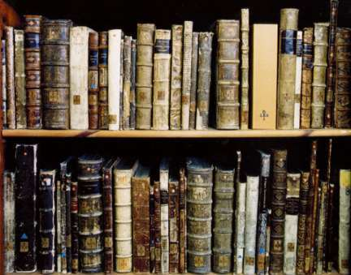
Mirando al Pasado..
Mirando al Futuro:
Ventajas de las Plataformas
Simultáneo y sin limitación en el numero de usuarios
Sin DRM
Búsqueda a través de libros y revistas
Disponibilidad 24/7
Y MUCHO, MUCHO MAS …
Notes:
Imagine—
Before online books, researchers relied upon finding the material they needed on the shelf
Elsevier’s long heritage of publishing leading eBooks started in 1580 at the House of Elzevier—and later in 1880 became Elsevier. From Gallileo to Sir Alexander Fleming, Einstein, and a long line of Nobel prize winners—Elsevier has always been associated with the most renowned authors—and the most rigorous process for producing and distributing high quality content. That matters to all users, in any format, and that will not change regardless of delivery.

Slide 40
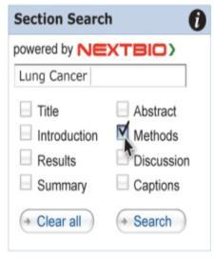
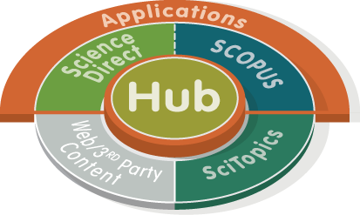
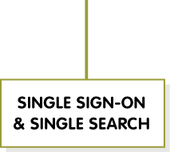
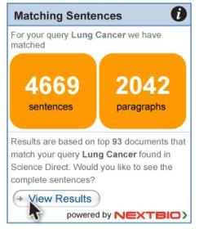
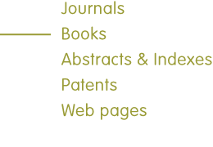
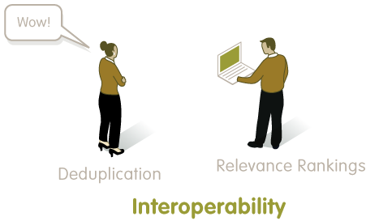
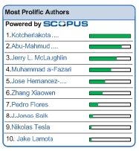
Desarrollos Recientes: SciVerse
Notes:
Elsevier launched SciVerse to bring together solutions like ScienceDirect, Scopus, the web content from Scirus, and SciTopics into one point of access, enabling more efficient search and discovery for our users. This new platform for science content addresses the most pressing needs of researchers, and the library and information professionals who support them. The goal: more value from subscribed content and less time spent unearthing new insights. SciVerse integrates the familiar, trusted content from ScienceDirect, Scopus and relevant scientific websites – with the forward-looking: community-developed applications that enrich and expand content value.
READ BENEFITS ON SLIDE TO ELABORATE

Slide 41
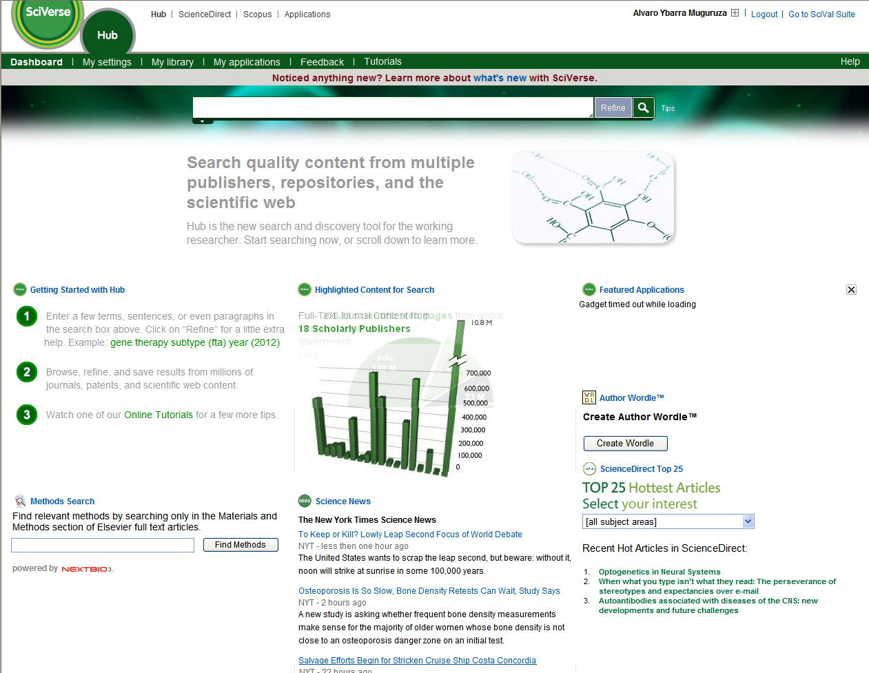
Desarrollos Recientes: Hub

Slide 43
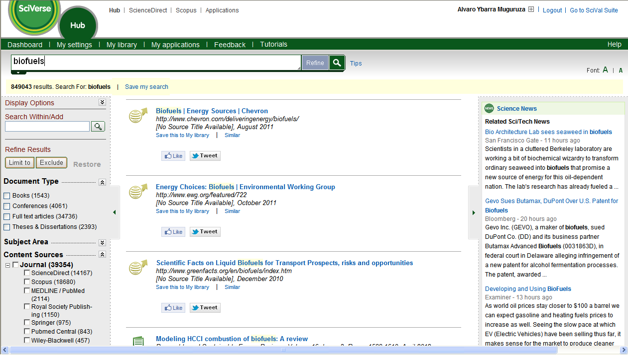

Slide 44
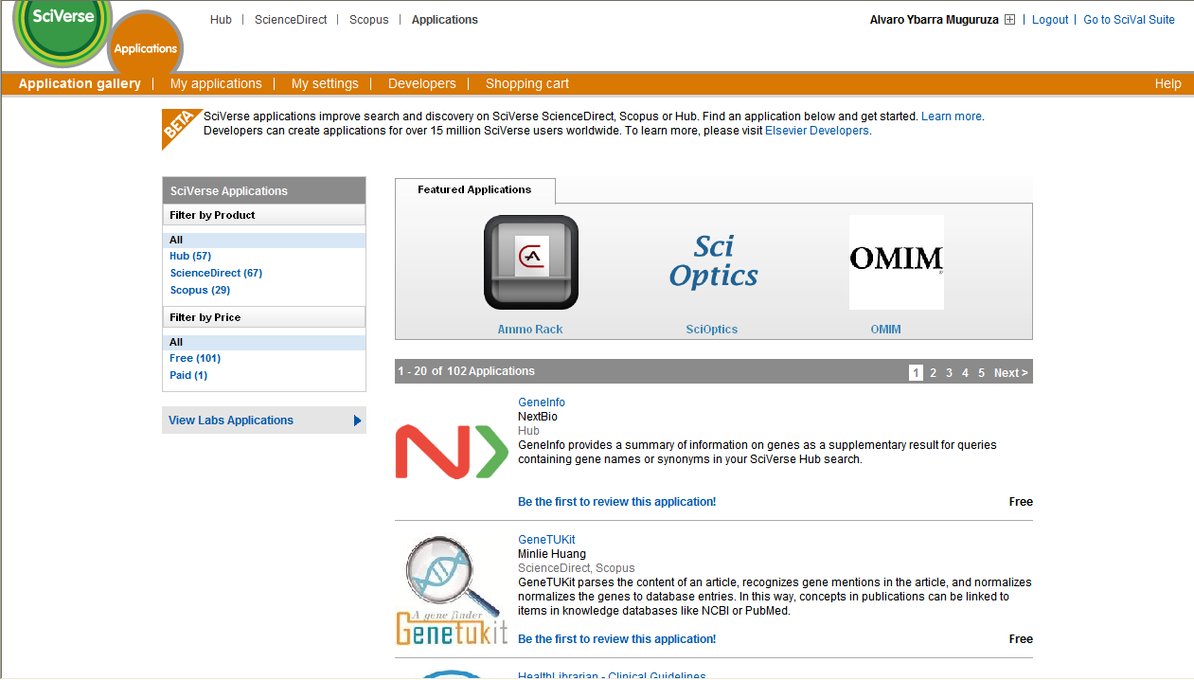
Desarrollos Recientes: Aplicaciones

Slide 45
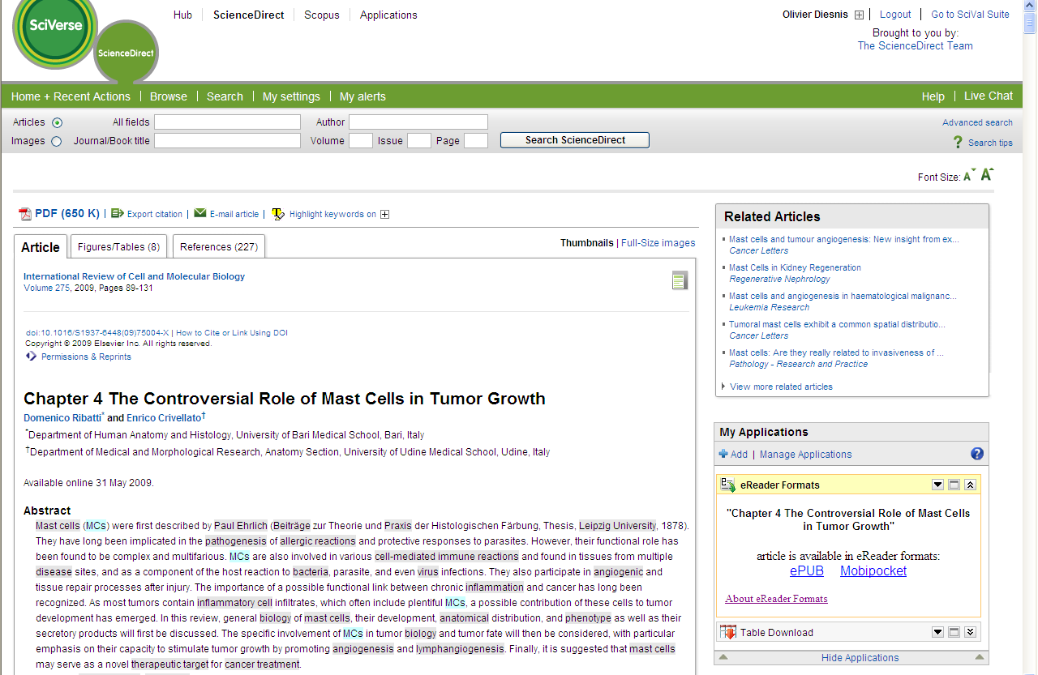
Aplicación de eReader y Kindle para ScienceDirect
Visible on SD article pages, for all XML articles/chapters
Two alternative downloading options for the article: EPUB and MOBI
Users Save and load file directly to their reader

Slide 46
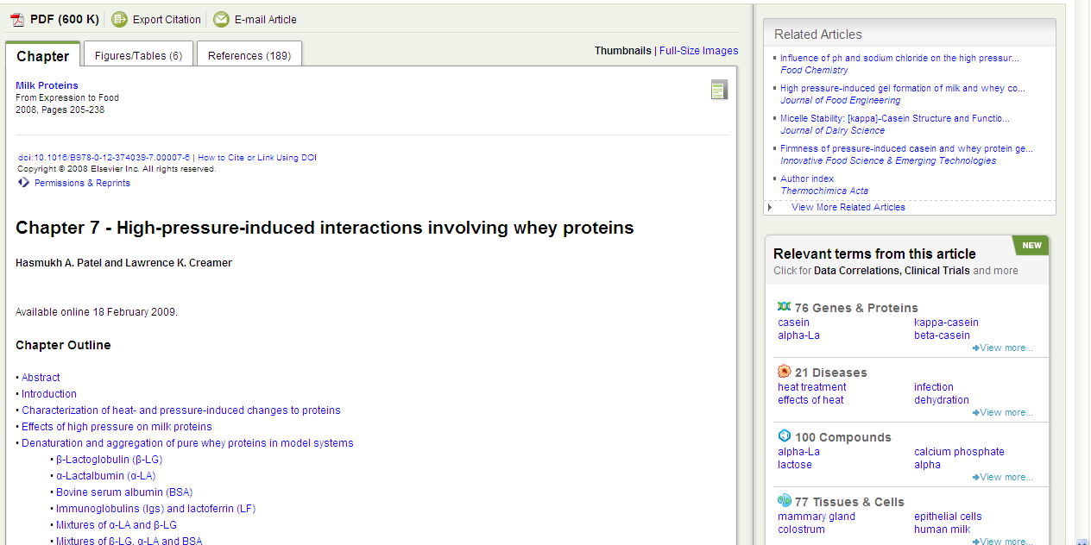
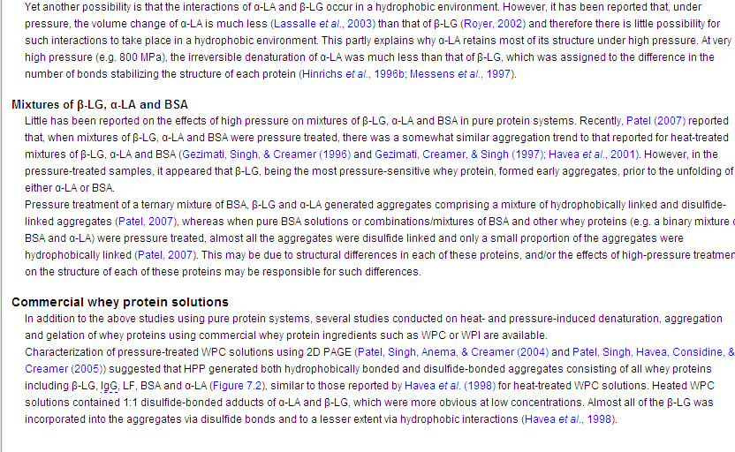
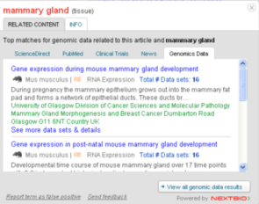
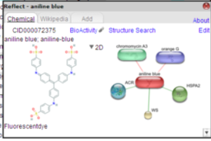
Ventajas de Plataforma: Búsqueda Semántica
Notes:
—but today’s technology enables the flexibility to find the content they need—when they need it.
With eBooks, flexibility features can include these:
Direct links to full text .pdf or full text HTML content
Multiple simultaneous users can access the same book at the same time—
Easy download and print
No DRM Restrictions
NEXT BIO: The Challenge
Researchers in Life Science, Health Science and Chemistry are faced with information overload. Scientific information on genes, pathways, diseases, tissues, compounds resides in various, disconnected locations e.g. sources like PubMed, the Web and institutional Library resources.
As a result, these researchers are required to spend a lot of time locating key information in order to stay up-to-date in their fields or to quickly get up to speed on a new discipline in order to collaborate with their peers. With minimal effort they want to be able to perform comprehensive searches across reliable datasets providing them with intelligent results bringing them the insights they need. They also need assurance that they are not missing out on information.
The Solution
ScienceDirect will be enhanced with NextBio\\'s unique set of ontology-based tools for text mining and through the addition of high-quality sources of public data that NextBio has collected and compiled. This enhancement highlights key relationships between data and will enable Life Sciences, Health Sciences and Chemistry researchers to simultaneously search dive deeply into ScienceDirect content alongside publicly available sources such as PubMed, experimental data, clinical trials, and news articles , improving scientific discoverability and research productivity.

Slide 47
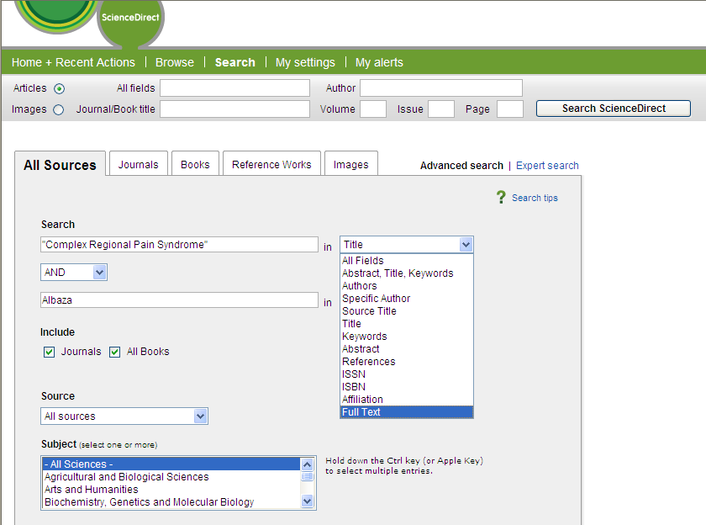
Ventajas de Plataformas : Búsqueda Integrada
Notes:
Powerful, integrated search functionality on ScienceDirect returns immediate, relevant results from both books and journals. It’s easy and intuitive to adapt and refine searches—or save and recall searchers to personalize and streamline the path likely to be taken by researchers in their areas of interest over and over again.
From quick search to advanced search, one of the most widely acclaimed benefits of the ScienceDirect platform is that users say they always find exactly what they need—and fast.

Slide 48
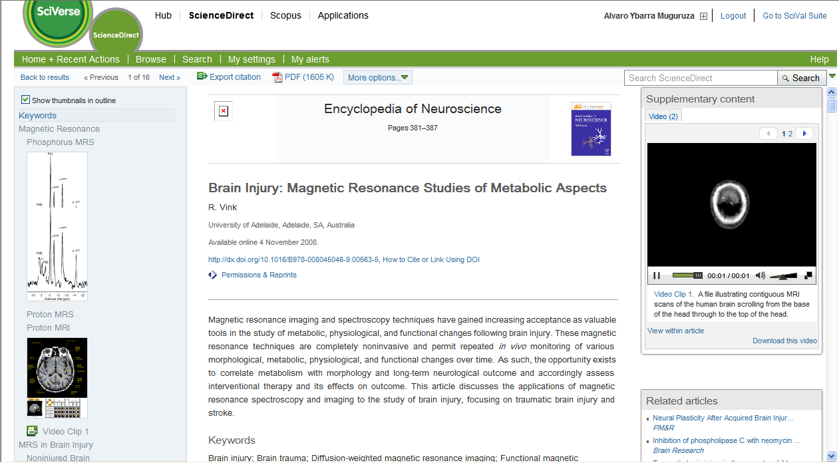
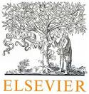

Slide 49
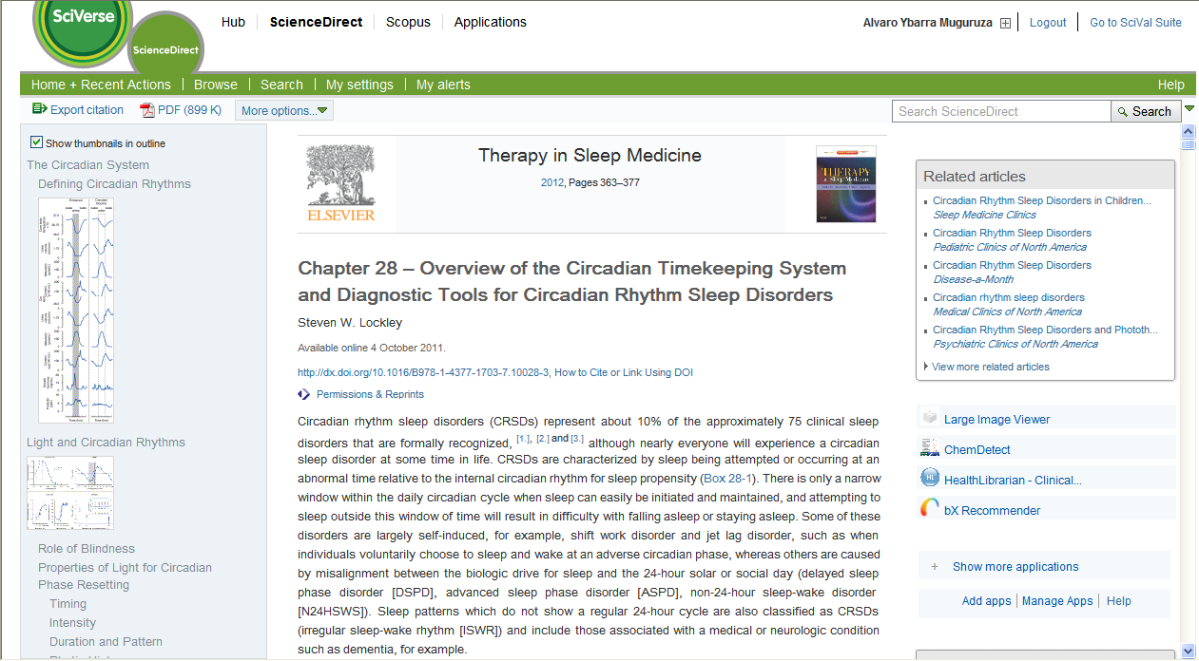

Slide 50
Desarrollos Recientes: Búsqueda de Videos

Slide 51
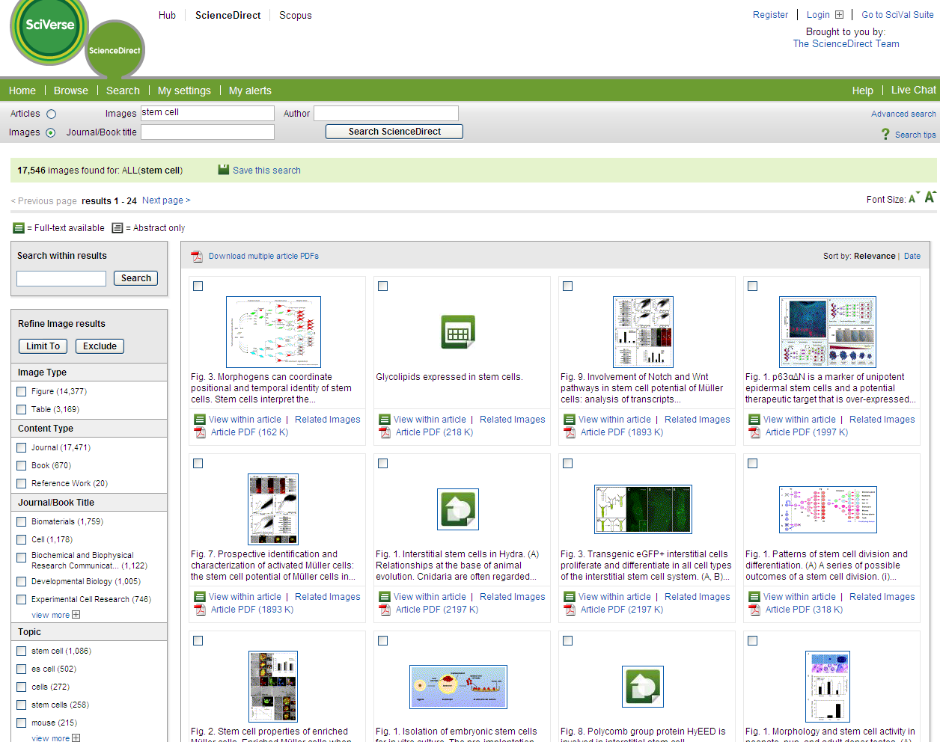
Desarrollos Recientes: Búsqueda de Imágenes
Notes:
Recent enhancements to the SciVerse ScienceDirect platform will continue to provide beyond the book benefits that make accessing books on a publisher provided platform more convenient and more effective than possible with printed works.
SciVerse Science Direct features Image Search for full-text articles and books (e.g. photos, tables, videos) Within many scientific fields images (tables, photos, figures, graphs, videos etc) are an important aid whether it is for researching, manuscript writing, teaching or creating presentations. While sources like Google, Google Images, Bing and Flickr are consulted to find images but how do you know the source of the image and if it’s trustworthy? Can the image be used or are there copyright restrictions? Also, when retrieving images from online scientific books and journals how can you easily locate images and not have to scan all relevant articles to finally stumble upon the matching image?
SO ScienceDirect further enhances the researchers’ workflow by adding image-specific searching to its search functionality. In addition to saving time by immediately delving into the visual part of the content ScienceDirect enables the researcher to also find a direct path to the image within the article in order to place its context.
Reference Work Helper ScienceDirect increases the research efficiency by providing essential and foundational information from reference works directly connected to the selected article. Researchers can easily access related basic knowledge for broadening their perspective or better understanding a new and unfamiliar topic. Libraries benefit from increased discoverability of the reference works purchased by the library. Allowing better integration and interoperability between both primary research in journals and secondary knowledge from reference works provides the library with increased visibility of its subscribed reference works content if they have both
offerings available to their patrons. The researcher benefits from having supporting information at their fingertips to quickly understand new concepts allowing them to increase their research efficiency. For non-subscribing institutes, the reference work articles are visible as well as a preview (including basic metadata about the article or chapter and either the abstract or a one page PDF excerpt) instead of the full text.

Slide 52
4. Movimiento Digital, Movimiento Portátil.
Notes:
STANFORD:
The Stanford School of Medicine giving iPads to all incoming medical students captured a great deal of attention – the story alone received tens of thousands of views. Recently, the School of Medicine highlighted how students have been using their iPads – commenting on how frequently they are being used, textbook capabilities, and even on how certain applications are being used. The school has also collected some preliminary data that quantitates how many of the 91 students who were given iPads are actually using them – or if they are using them at all. Brian Tobin, the school’s instructional technology manager has stated students are customizing their usage of the iPad based on how it helps them to study:
ADELAIDE:
"We will be the first university in Australia to teach in this innovative way. Our teaching material will be more accessible, more relevant and more frequently updated, providing the flexible learning environment that students are looking for.

Slide 53
La Universidad de Adelaide entrego 700 IPads a 700 estudiantes y profesores en 2011
Movimiento Digital,
Movimiento Portátil
St
Universidad de Stanford : Nuevos estudiantes de medicina recibiendo Ipads
Notes:
STANFORD:
The Stanford School of Medicine giving iPads to all incoming medical students captured a great deal of attention – the story alone received tens of thousands of views. Recently, the School of Medicine highlighted how students have been using their iPads – commenting on how frequently they are being used, textbook capabilities, and even on how certain applications are being used. The school has also collected some preliminary data that quantitates how many of the 91 students who were given iPads are actually using them – or if they are using them at all. Brian Tobin, the school’s instructional technology manager has stated students are customizing their usage of the iPad based on how it helps them to study:
ADELAIDE:
"We will be the first university in Australia to teach in this innovative way. Our teaching material will be more accessible, more relevant and more frequently updated, providing the flexible learning environment that students are looking for.

Slide 54
54
Aplicaciones Móviles: iPhone, iPad, Android y Blackberry
Developing Hybrid Apps Across Application Marketplaces
- iPhone
- iPad Application
iPhone app available to users at subscribing institutes only.
Notes:
Generic ScienceDirect App
Provides the most important SD productivity tasks, any time and anywhere
Search, Browse, Article view, PDF view
Highly personalized with interactive features, alerts and journals
Article content delivered in html
Alerts, annotation and sharing

Slide 55
5. Colecciones Ebooks
Autores de Elsevier:
Albert Einstein -Fisica
George F. Smoot - Fisica
John C.Mather - Fisica
Roger D. Kornberg - Quimica
Craig C Mello - Medicina
Alexander Fleming - Medicina
Niels Bohr - Fisica
Louis Pasteur - Quimica

Slide 56
Colecciones Ebooks

Slide 57
Colecciones Ebooks
NUEVAS
Clinical Medicine
Health Professions
Veterinary Medicine
Biomedical Science and Medicine
Forensics

Slide 58
Colecciones Ebooks 2012

Slide 59
Únete a nuestra Comunidad—
Mas de 35,000 Bibliotecarios & Investigadores colaborando a diario!
www.facebook.com/elsevierlibrarians
www.twitter.com/elsevierscience
81% de los Investigadores estan de acuerdo:
“En los próximos años, se utilizaran redes de conocimiento, como fuentes fidedignas para filtrar & ver información..”
www.youtube.com/elsevierbooks

Slide 60
http://thefactofmyignorance.com/wp-content/uploads/2009/10/CalvinandHobbesCivilityFinal.jpg

