Slide 2
Taller MDPI y la publicación en abierto
Presentación de MDPI
Diferencias entre open access y modelo tradicional
Proceso editorial
Otros servicios de MDPI

Slide 3
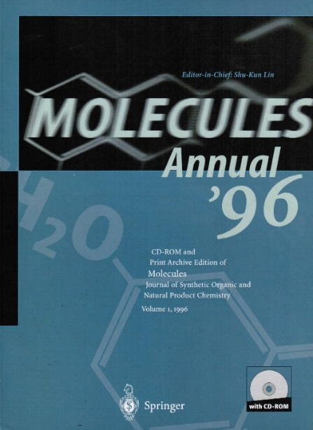
MDPI—20 años de Open Access
MDPI fue fundada en el año 1996 por el Doctor Shu-Kun Lin, doctorado en Química Orgánica por el centro ETH (Eidgenössische Technische Hochschule) en Zürich.
El proyecto se lanzó con la intención de preservar compuestos químicos raros procedentes de las Universidades siendo publicados en la revista Molecules.
MDPI es una editorial científica pionera del modelo Open Acces, publicando en este formato desde hace más de 20 años.

Slide 4
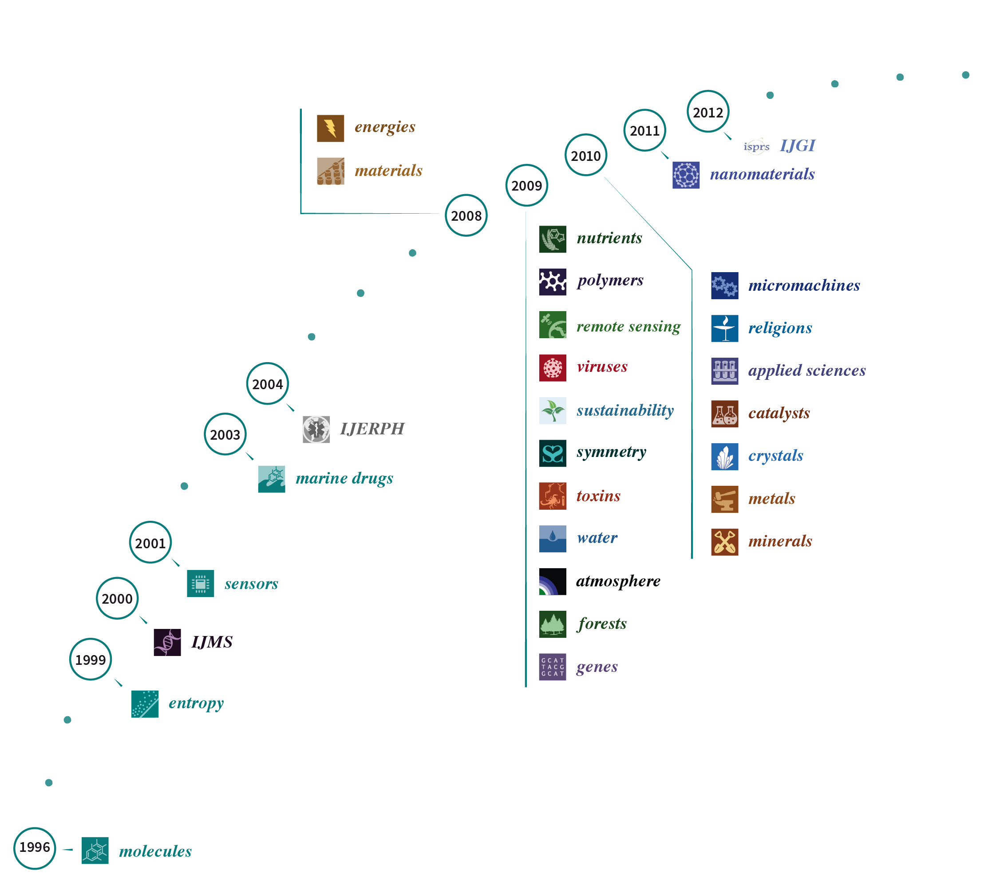

Slide 5
Nuestra misión:
Incrementar la libre accesibilidad de la ciencia a través de revistas científicas de acceso abierto que faciliten el intercambio científico

Slide 6
Visión y Valores
Proporcionar un Servicio Excelente a los investigadores
Calidad
Eficiencia
Flexibilidad
Servicio Excelente El 99% de nuestros autores publicaría con MDPI de nuevo
Proceso de publicación rápido La primera decisión se da en una media de 24 días y se publica en 7 días después de ser aceptado

Slide 7
Visión y Valores
MDPI es miembro de:

Slide 8
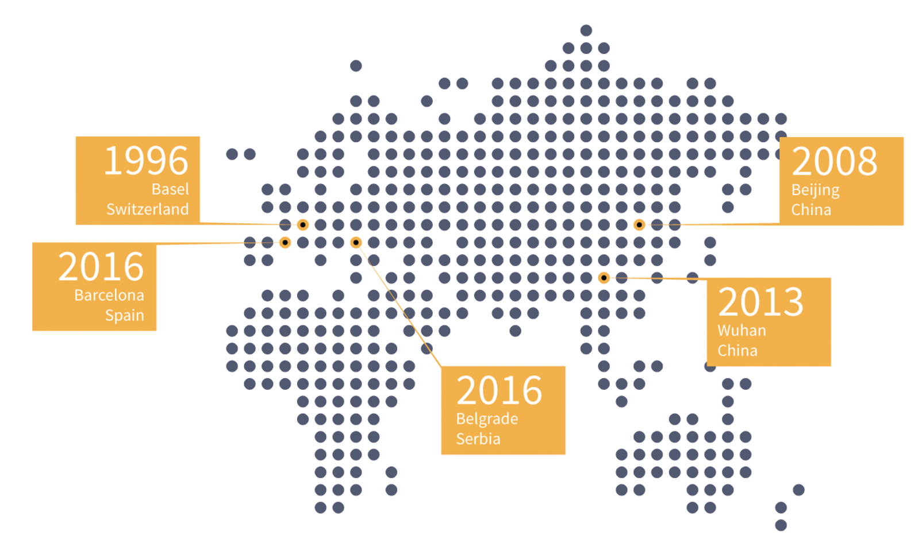
Nuestro equipo
900+ empleados
6 oficinas en Basilea, Pekín, Wuhan, Barcelona, Belgrado

Slide 9
Algunos Datos
170
revistas de acceso abierto
91 revistas indexadas en Web of Science
29 revistas indexadas en SCIE con Factor de Impacto
268,301 autores desde 1996
15,700 editores académicos (externos)
102,790
artículos publicados desde 1996
94,791 autores en 2016
23,568 artículos publicados en 2016
125,616 peer-reviews recibidos en 2016
5,870,600 visitas mensuales a mdpi.com

Slide 10
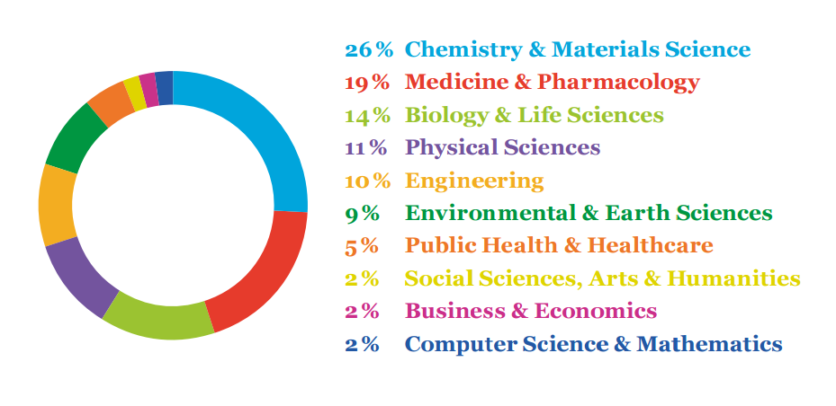
Portfolio de revistas

Slide 11
MDPI en el Mercado en Acceso Abierto
Fuente: Sciforum statistics
sciforum.net/statistics

Slide 12
MDPI en el Mercado en Acceso Abierto

Slide 13
Open Access
Open access (OA) indica los resultados de investigaciones de libre acceso y sin la mayoría de restricciones para su uso futuro (copyright y licencias).
El término open access fue formulado por primera vez a principio de los años 2000 en tres declaraciones públicas: con ocasión de la Budapest Open Access Initative (2002), el Bethesda Statement on Open Access Publishing (2003) y en la Declaración de Berlín (2003).
El concepto inicial de open access implica al acceso sin restricciones a la investigación, y se refiere principalmente a los artículos publicados en revistas académicas

Slide 14
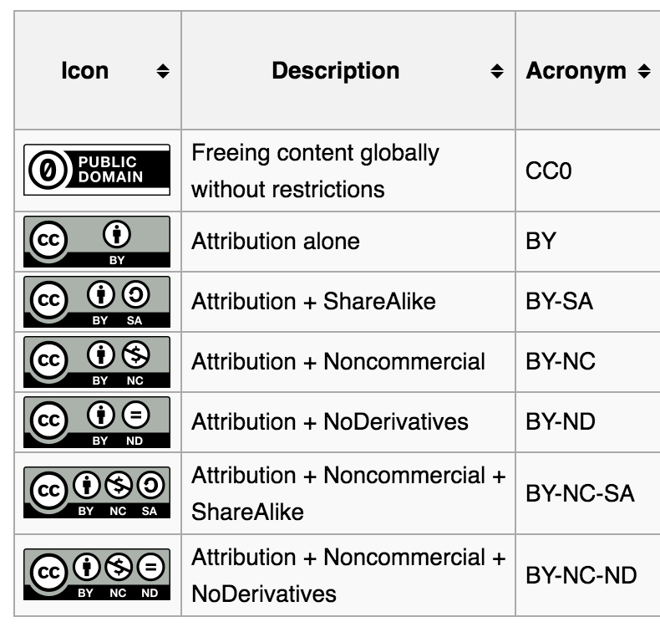
Open Access y licencias
La licencia Creative Commons (CC) es una de las licencias que permite la libre distribución de contenidos que, diversamente, estarían protegidos por copyright.
Las licencias CC se usan para permitir el uso, la distribución y el desarrollo de un trabajo.
Este tipo de licencia ofrece máxima flexibilidad a los autores (por ejemplo, la reutilización de su trabajo puede ser limitada a usos no comerciales) y protege quien utiliza el trabajo de posibles problemas de copyright.

Slide 15
Acceso abierto vs Modelo de suscripción
Open Access
Todos los artículos se encuentran online y son accesibles de manera gratuita por los lectores.
Todos los artículos se publican bajo la licencia Creative Commons License (CC-BY).
Peer-review
El trabajo editorial se apoya económicamente en las APCs (Article Processing Charges ) pagadas por los autores y/o sus instituciones.
Suscripción
Los artículos se encuentran disponibles para los investigadores si la Universidad tiene una suscripción.
Los artículos se publican mediante licencias de Copyright restrictivas transferidas a la editorial.
Peer-review.
Los autores a veces pagan tasas por páginas adicionales o imágenes en color.

Slide 16
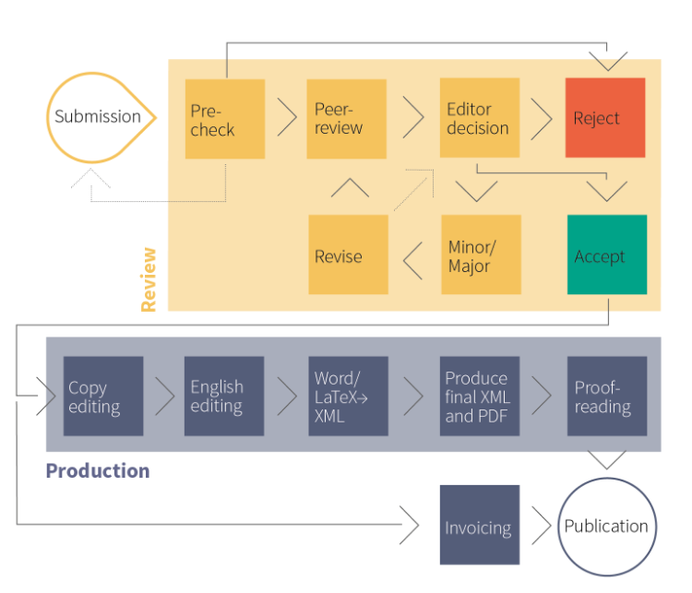
Proceso editorial

Slide 17
Proceso de peer-review
Proceso sencillo, rápido, eficiente y riguroso.
24 días para la primera decisión.
7 días desde que se acepte el artículo hasta que esté publicado (Edición de formato, Edición de inglés, conversion a XML).
Más de 12.800 Editores Académicos en todo el mundo.
Trabajo de los revisores acreditado por Publons.
Descuentos de hasta 250 CHF para los revisores.
In-house submission system: Susy.
Notes:
Detrás del proceso de revisión hay un Sistema desarrollado por MDPI. The MDPI online submission system, Susy, incorporates online tools for manuscript submission, peer-reviewing and editorial decision making. The reviewers and external editors will not need to have an account with the MDPI submission system in order to finish the tasks assigned to them. Rather, the system will recognize the reviewers and external editors through one-time usable IDs in the URLs. Editors-in-Chief and Guest Editors can view articles submitted to their journal or special issue via Susy at any time.

Slide 18
Copy Editing
Llamamos copy editing al proceso a través del cual mejoramos el formato, el estilo y la precisión del texto. El objetivo de este proceso consiste en reducir errores, omisiones, incongruencias y repeticiones.
La edición mecánica es el proceso de revisión de un texto para adaptarlo al formato de cada editorial. Incluye el control de abreviaturas, acrónimos, mayúsculas, cursivas, formato de números, etc.
La edición de contenido consiste en reorganizar y reestructurar un documento. Los editores no podemos modificar directamente, reescribir o corregir el texto; sin embargo, podemos subrayar pasajes difíciles o pedir al autor que trabaje para aumentar la legibilidad del artículo.
Los editores no somos los responsables del contenido o de la exactitud de los artículos, pero podemos proporcionar comentarios útiles para evitar incomprensiones o discrepancias. En todo caso, nuestro trabajo consiste en mantener “la voz del autor”.

Slide 19
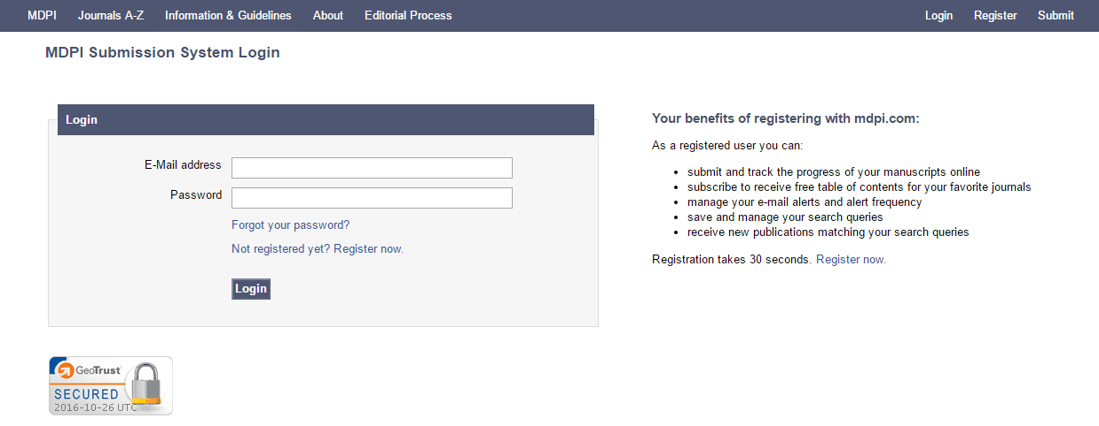
Acceso a SuSy

Slide 20
SuSy—¿Por qué registrarse?
Como usuario registrado podrás:
Enviar y seguir los progresos de tu artículo online.
Suscribirte a la newsletter de tu revista favorita.
Gestionar el tipo de alerta que quieras recibir por correo y su frecuencia.
Guardar y modificar tus criterios de búsqueda.
Recibir nuevas publicaciones que encajen con tus criterios de búsqueda.

Slide 21
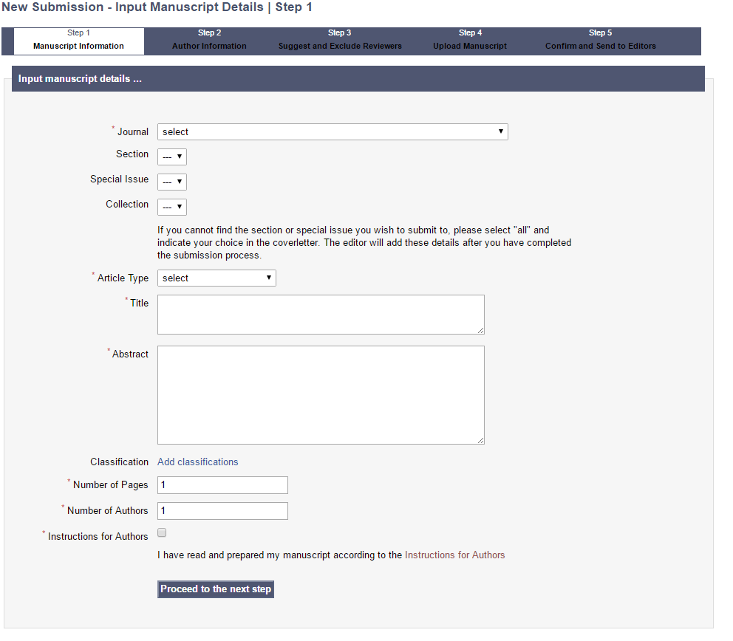
SuSy – Submit Manuscript

Slide 22
MDPI Sciforum
Compartir e Intercambir Archivos Online
Conferencias Electrónicas
Conferencias Físicas
Grupos de Colaboración
Grupos de Discusión
Motor de búsqueda
Notes:
Sciforum is a platform for scholarly exchange and collaboration developed and maintained by MDPI in beautiful Basel, Switzerland. With Sciforum you can:
Participate in online conferences
Share scholarly papers and other files
Create or join discussion groups
Collaboratively manage bibliographies
Electronic Conferences / Virtual Conferences
Electronic conferences (or e-conferences) are scholarly events that are hold online on this platform during a limited period of time. As they are online, anyone can attend from virtually anywhere. During the time of the conference, participants can discuss online on the conference pages. Proceedings papers and discussions are directly archived on Sciforum for posterity. Typically the electronic conferences on Sciforum are free to participate for both, presenters and attendees.
Traditional Conferences
Sciforum is also the home of a few traditional ("real life") conferences. For those events, Sciforum will typically serve as the platform for registering with the conference, and for the submission of abstracts and manuscripts. Depending on the conference, presentations and proceedings papers will be made available on Sciforum after the event.
Discussion and Collaboration Groups
In Fall 2014 we launched our discussion and collaboration groups. Anyone with a registered account can create a new group. Groups can be either closed access (private groups, members are moderated by the group owner) or open access groups (anyone can join and participate with the groups). Invite people, share files, create a discussion group around the paper.
Each group is linked to a mailing list, meaning that the messages posted online on Sciforum will be distributed to the group members by e-mail on a regular basis.
Our discussion groups offer a few handy tools for scholars, such as a shared bibliography management tool, export of citations in different formats, sharing and exchanged of files in private groups or directly amongst members of the platform, etc.
SciFeed: Your Customizable Scientific Feed.
Welcome to SciFeed, the academic service that keeps you informed by email as soon as new articles matching your query are published. SciFeed searches the literature database SciLit which contains more than 85 millions of articles. SciLit is updated everyday, based on new publications deposited to CrossRef.

Slide 23
MDPI Preprints
Información de Todos los Campos
Búsqueda Optimizada
Achivamiento Permanente (DOI)
Actualización Inmediata
Citación Inmediata
Compartir Contenido Online
Notes:
Preprints is a free (not-for-profit) multidisciplinary preprint platform that makes scientific manuscripts from all fields of research immediately available at www.preprints.org.
The advanced search function of Preprints allows for a search by keywords in the article or in the comments, author name, author affiliation, subject areas, disciplines, or date posted.
Readers can share preprints on social media and bookmark them on external services such as CiteULike, Mendeley, BibSonomy, Reddit, or Delicious.
Preprints will permanently archive full text documents with specialist services that cater for long‐term preservation.
All posted preprints are immediately citable by their assigned digital object identifier (DOI). Preprints encourages authors to post updates of their working manuscript as research progresses. From the first draft to the final document, every version is independently citable with its unique DOI.
A preprint is any article that hasn’t yet been peer-reviewed and published in an academic journal. In most cases, you can think of it as a draft or working paper. A preprint can be updated and improved at any time.
What’s unique about Preprints compared with other preprint archive servers?
Posting Preprints in All Research Fields Today’s major preprint platforms focus on specific research fields. We want to ensure that all academics are able to establish research precedence by using a multidisciplinary preprint platform. This is why Preprints matters. We are Making Research Discoverable, Sharable and Citable Open science calls for transparent and public dissemination of scientific content. This means that a preprint service requires optimized search, possibilities to share content in scientific communities, reliable archiving, and the possibility to immediately cite content.
The advanced search function of Preprints allows for a search by keywords in the article or in the comments, author name, author affiliation, subject areas, disciplines, or date posted.
Readers can share preprints on social media and bookmark them on external services such as CiteULike, Mendeley, BibSonomy, Reddit, or Delicious.
All posted preprints are immediately citable by their assigned digital object identifier (DOI). Preprintsencourages authors to post updates of their working manuscript as research progresses. From the first draft to the final document, every version is independently citable with its unique DOI.
Types of Paper Accepted
Preprints publishes any article that reports original research results or a comprehensive review of a field. As such, the following types of articles are suitable: Article, Review, Conference Paper, Data Descriptor, Brief Report, Case Report, Communication, Short Note, Technical Note, Hypothesis. Other types of articles may be accepted at the discretion of the editorial team.
Copyright and Licenses
All preprints are posted with a CC BY and authors grant Preprints a license to distribute the article, which states:
I grant Preprints a perpetual, non-exclusive license to distribute this article.
I certify that I have the right to grant this license.
I understand that submissions cannot be completely removed once accepted by Preprints.
Preprints does not accept content created by a third party that has not authorized distribution. Authors should be aware that articles uploaded cannot be published in a journal that prohibits prior distribution on an e-print server. If your paper is published elsewhere and you want to post it on Preprints, you must obtain permissions from for any materials that you do not hold copyright to, and include the permission in your submission.
All preprints are released under a CC BY license, and CC BY or CC0 licenses for associated datasets.
Retracting a Manuscript
Submissions can be deleted before they are accepted by Preprints editorial office. Once accepted, authors can request to withdraw a manuscript, but must provide a compelling reason for doing so. Preprints retains the right to refuse requests for withdrawal or to retract manuscripts considered to have contravened the publication policy. Withdrawn preprints will no longer be available to download as a PDF document and will be marked as "Withdrawn". The public article page will still be kept as a record.
Committee on Publication Ethics (COPE)
Preprints is maintained and operated by MDPI, a publisher of open access journals. MDPI and Preprints adhere to the COPE Code of Conduct and Best Practice Guidelines. Manuscripts containing original descriptions of research conducted on humans or experimental animals must contain details of approval from a properly constituted research ethics committee. As a minimum, the project identification code, date of approval and name of the ethics committee or institutional review board should be cited in the “Methods” section.
Supplementary Materials, Data Deposit and Software Source Code
In order to maintain the integrity, transparency and reproducibility of research records, authors are strongly encouraged to make their experimental and research data openly available by depositing data in Preprints along with the manuscript. For papers in which new computer code (e.g., analytical bioinformatics tools or computer simulations) is of central importance, the authors are encouraged to release custom computer code either by depositing in public source code repositories or by announcing the source code as supplementary material to the paper. Additional data and files can be uploaded as "Supplementary Files" during the manuscript submission process. Accepted file formats include (but are not limited to):
data tables and spreadsheets (text files, MS Excel, OpenOffice, CSV, XML, etc.)
text documents (text files, PDF, MS Word, OpenOffice, etc.;
images (JPEG, PNG, GIF, TIFF, BMP, etc.)
videos (AVI, MPG, QuickTime, etc.)
executables (EXE, Java, etc.)
Citations and references in supplementary files are permitted provided that they also appear in the main text and in the reference list. The journal Data (ISSN 2306-5729) also accepts submissions of dataset papers, and the publication of small data sets along with the paper, and/or software source codes is encouraged.
Reproducing Published Material from Other Publishers
It is absolutely essential that authors obtain permission to reproduce any published material (figures, schemes, tables or any extract of a text), which does not fall into the public domain, or for which they do not hold the copyright. The authors must request permission from the copyright holder prior to posting to Preprints (please refer to the imprint of the individual publications to identify the copyright holder).
Permission is required for:
Your own works published by other publishers and for which you did not retain copyright.
Substantial extracts from anyone's works.
Use of tables, graphs, charts, schemes and artworks, if they are unaltered or only slightly modified.
Photographs for which you do not hold copyright.
Permission is not required for:
Reconstruction of your own table with data already published elsewhere. Please notice that in this case you must cite the source of the data in the form of either "Data from..." or "Adapted from...".
Reasonably short quotes are considered fair use and therefore do not require permission.
Graphs, charts, schemes and artworks that are completely redrawn by the authors and significantly changed beyond recognition do not require permission.

Slide 24
MDPI books
Open Access
Diferentes formatos
Peer Review
Alta visibilidad: directory of Open Access Books
Print on demand
Publicación rápida

Slide 25
Servicio de corrección de inglés
Revisión de ortografía, gramática y puntuación
Reelaboración de frases largas y complicadas
Edición de archivos Word y LaTeX
Los manuscritos son editados y devueltos a los autores en dos días
Corrección del uso de términos técnicos comunes
Precio competitivo

Slide 26
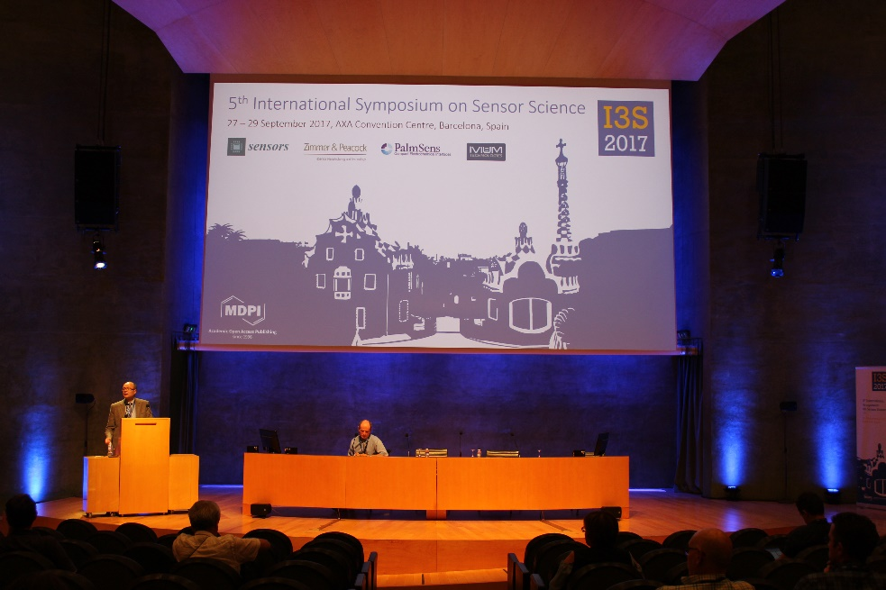
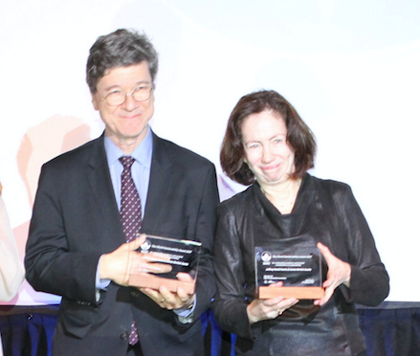
Conferencias de MDPI

Slide 27
Institutional Open Access Program
Más de 250 instituciones ya inscritas en todo el mundo, 26 en España (www.mdpi.com/about/memberships)
10% de descuento en las tasas de publicación para los autores de la Universidad de Sevilla
Acceso institucional exclusivo a nuestro Submission System “SuSy”, para garantizar la transparencia durante el procesamiento de los artículos

Slide 28
Stay Connected
@MDPIOpenAccess
MDPIOpenAccessPublishing
https://www.linkedin.com/company/mdpi
www.mdpi.com
ioap@mdpi.com
@

Slide 29
Academic Open Access Publishing since 1996 www.mdpi.com

